Slide 1
ANALYSIS and prediction of COVID-19 in SOUTH KOREA on 2020
Python programming
Sohyeon ju

Slide 2
Index
Objective for this project
Time analysis
Time gender analysis
Time province analysis
Patient info analysis
Data merging

Slide 3
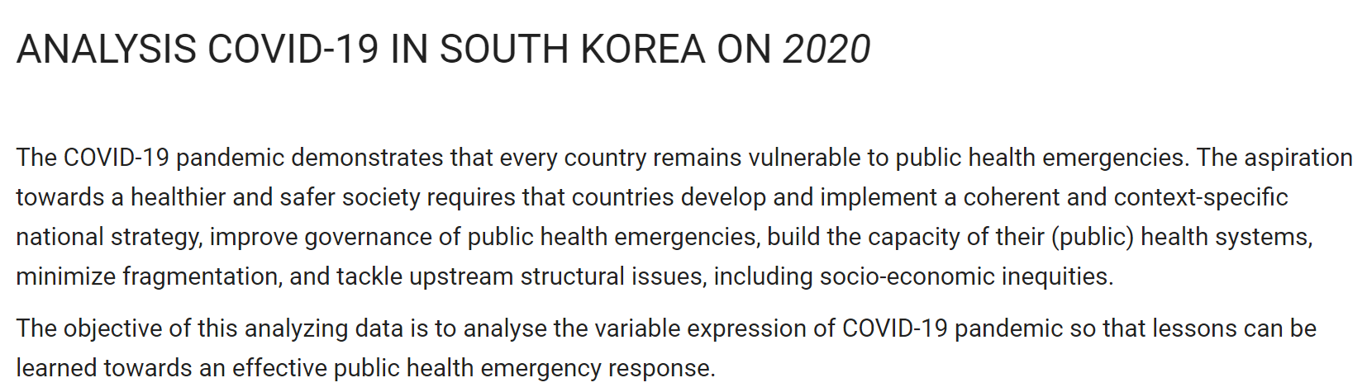

Slide 4
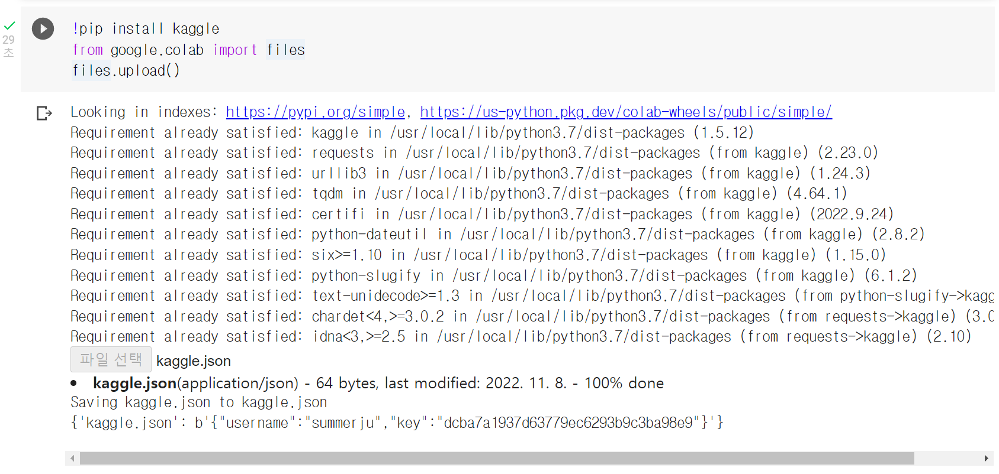

Install dataset from kaggle

Slide 5
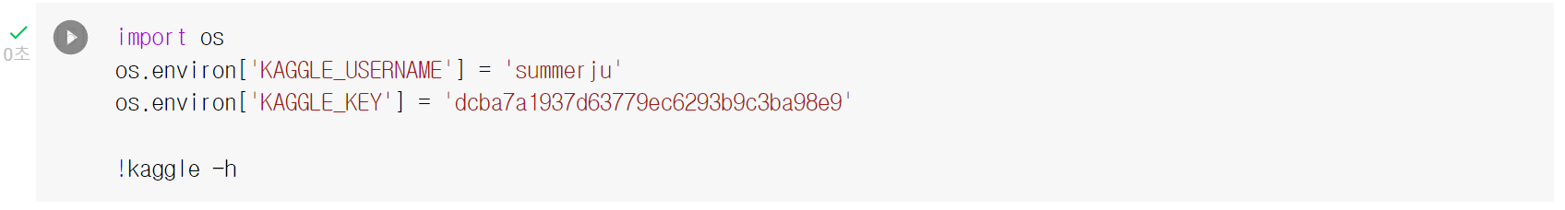
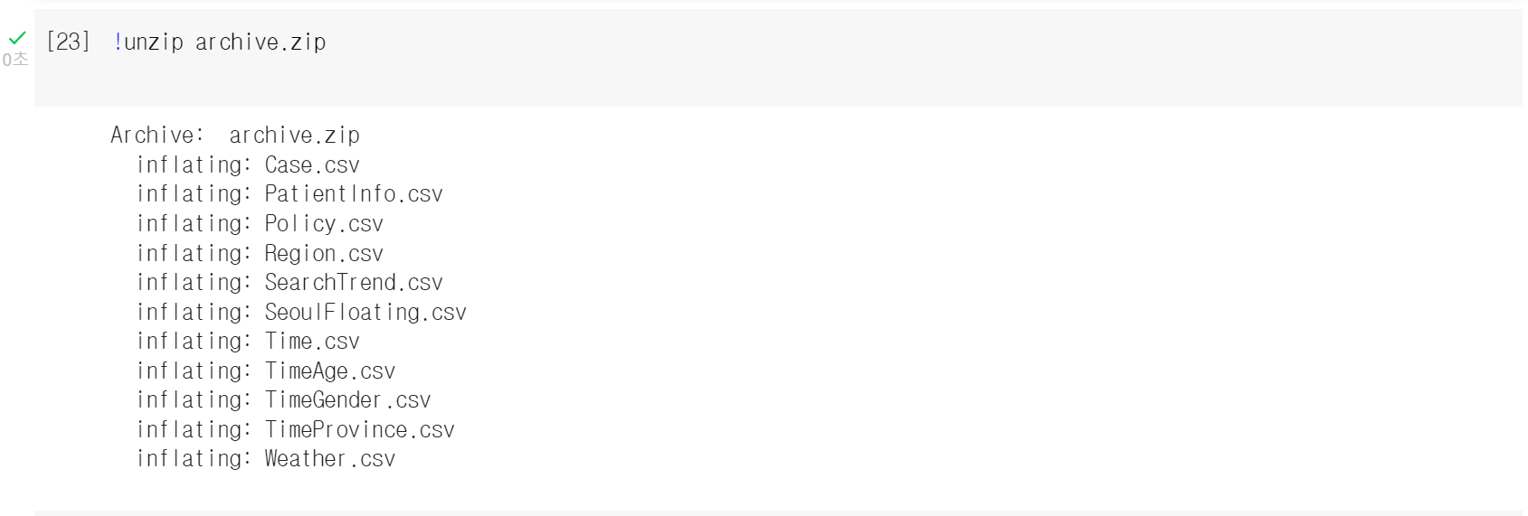
Install dataset from kaggle
Dataset source link
[NeurIPS 2020] Data Science for COVID-19 (DS4C) | Kaggle

Slide 6
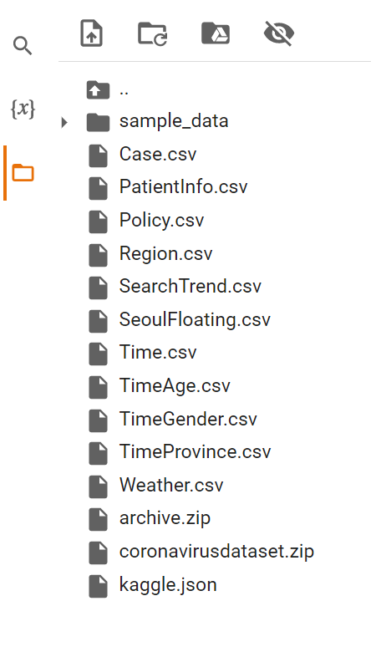
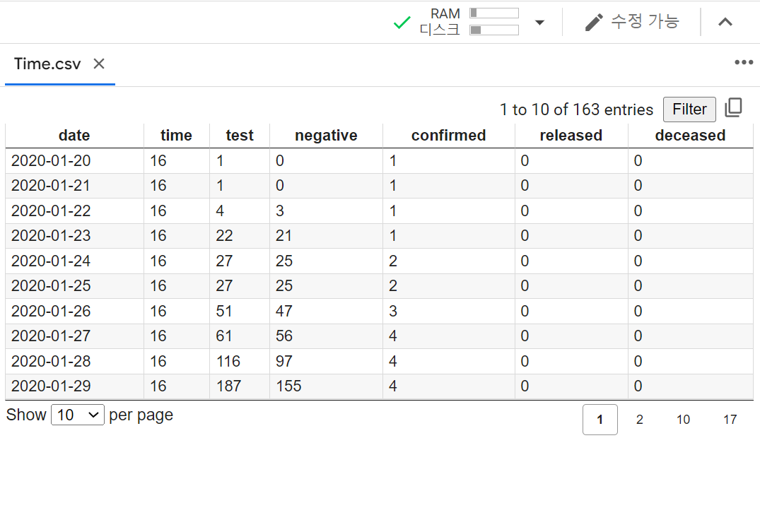
Ready for analyze

Slide 7
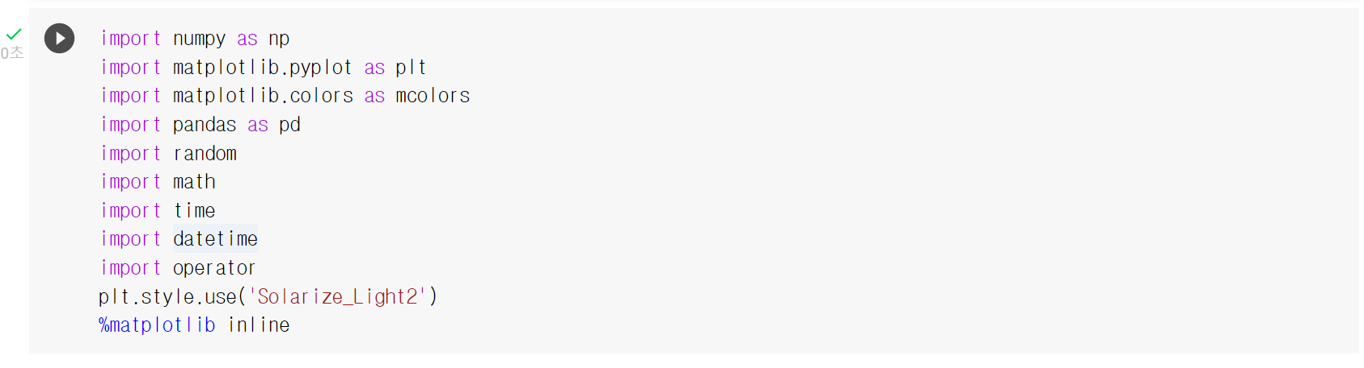
Import library

Slide 8
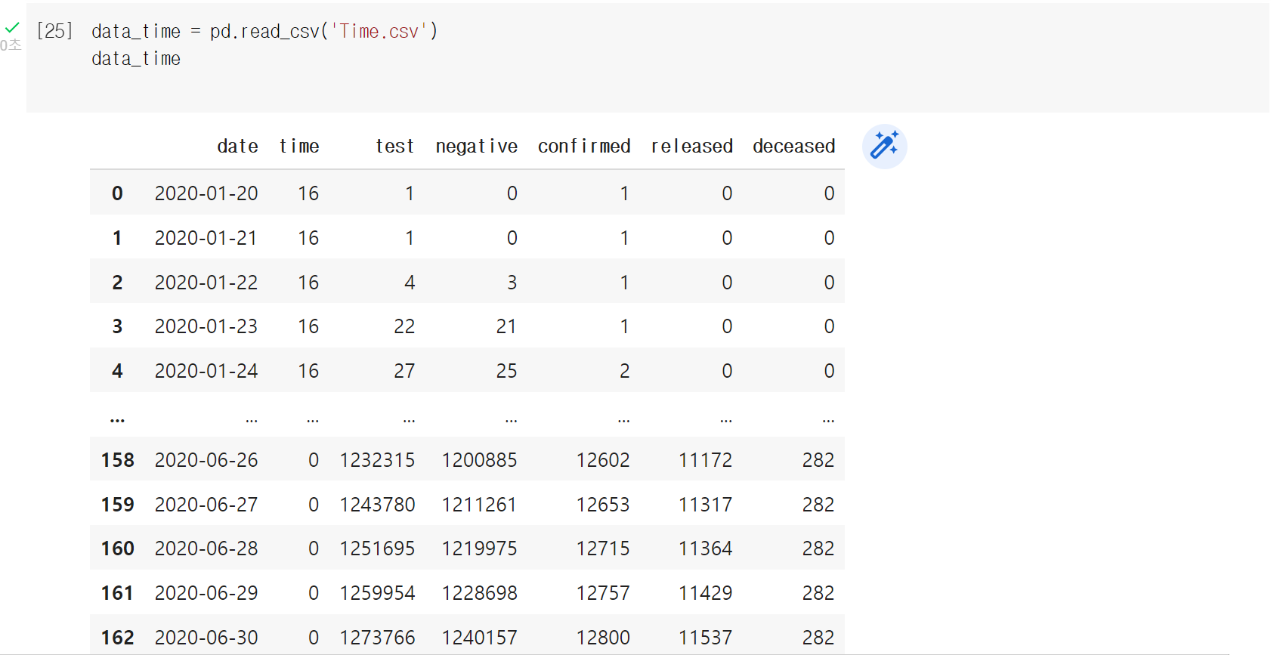
Time analysis

Slide 9
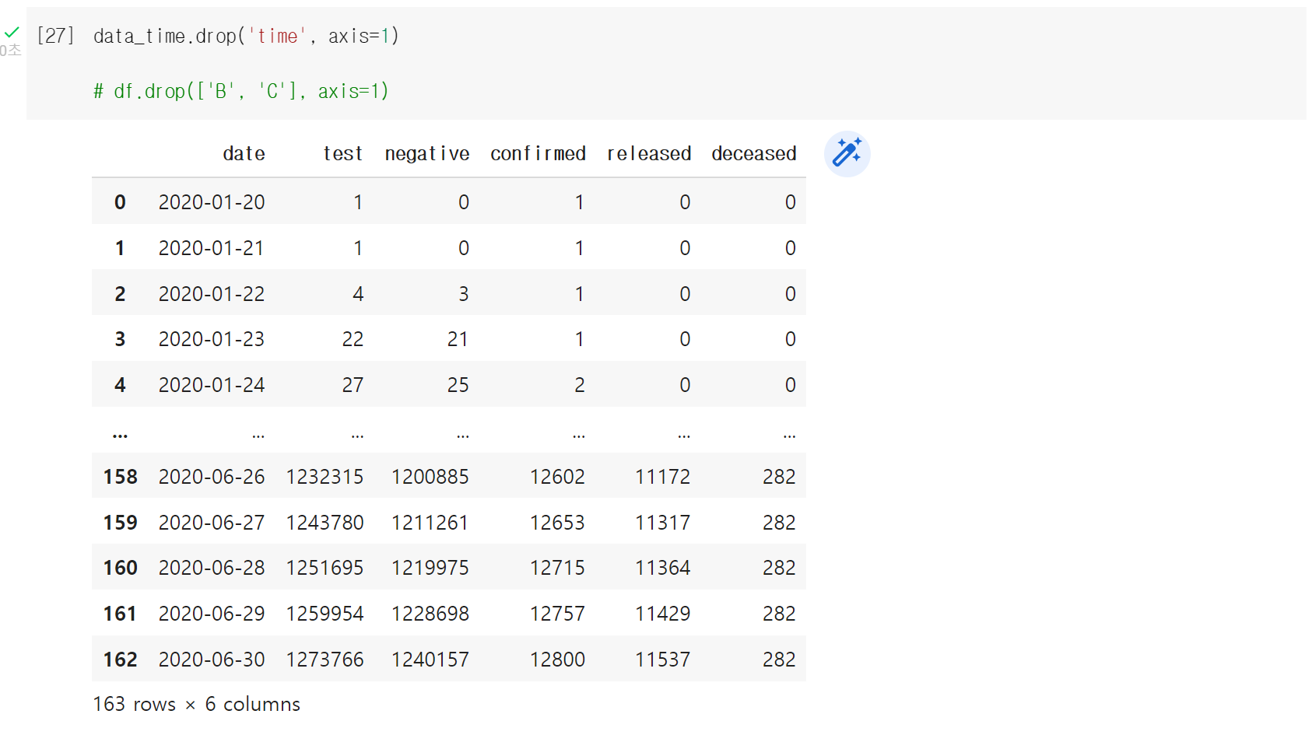
Time analysis and drop column

Slide 10
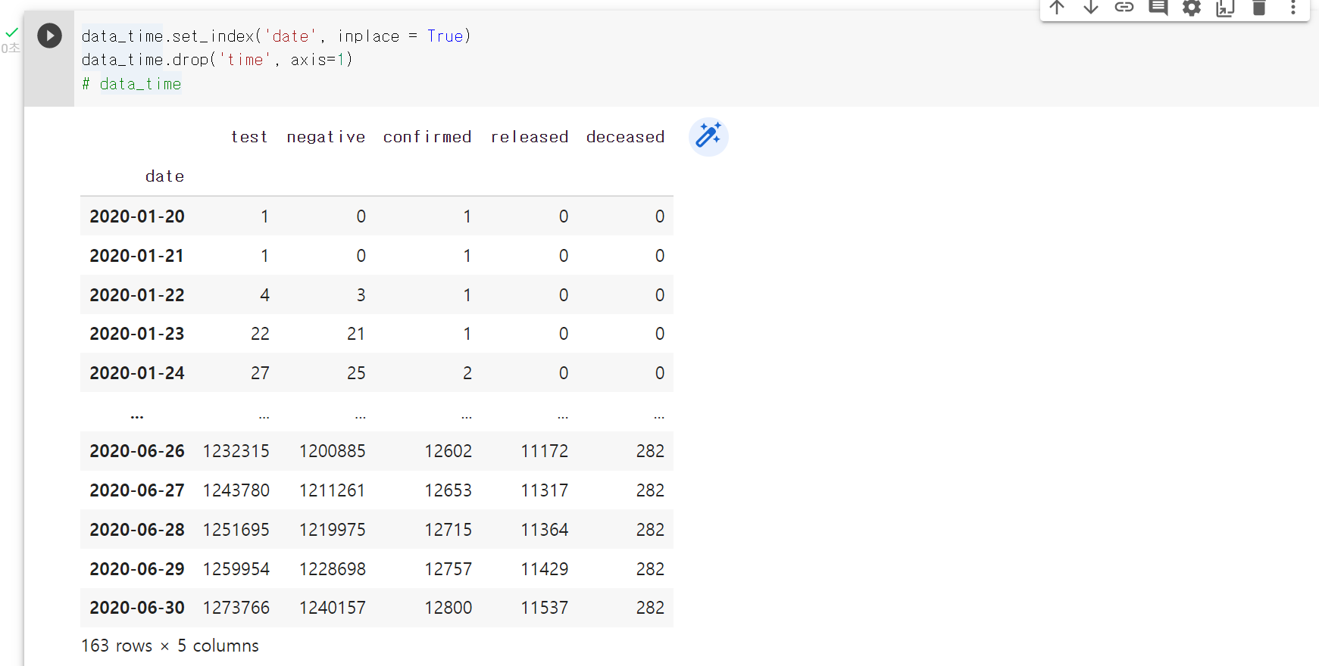
Set index

Slide 11
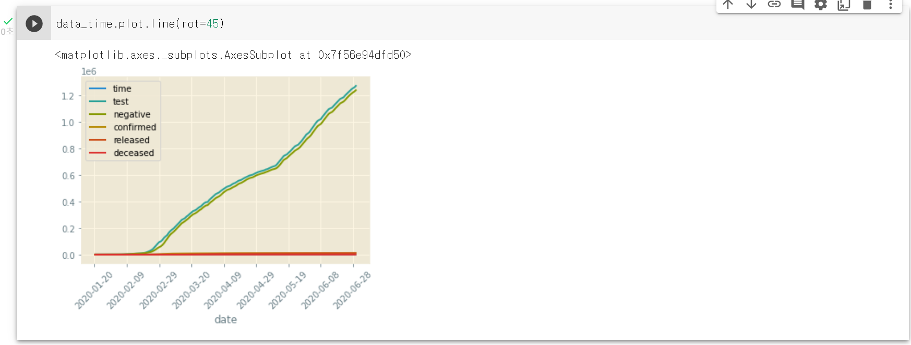
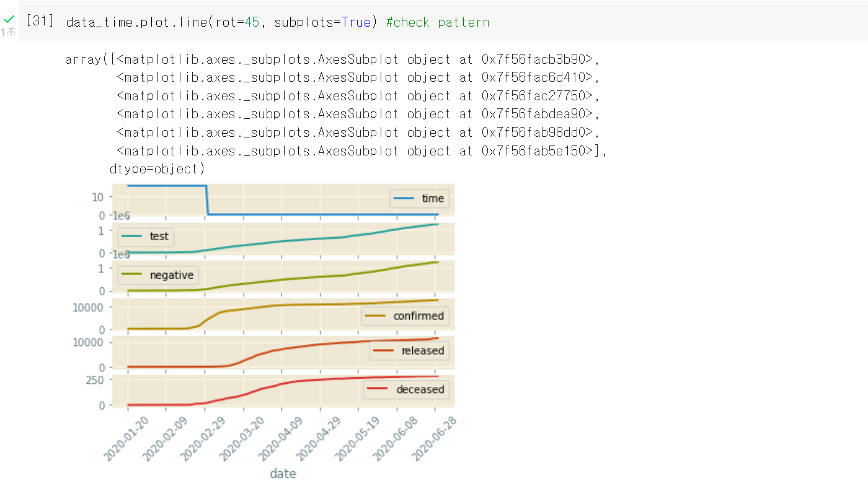
Making data plot and subplots

Slide 12
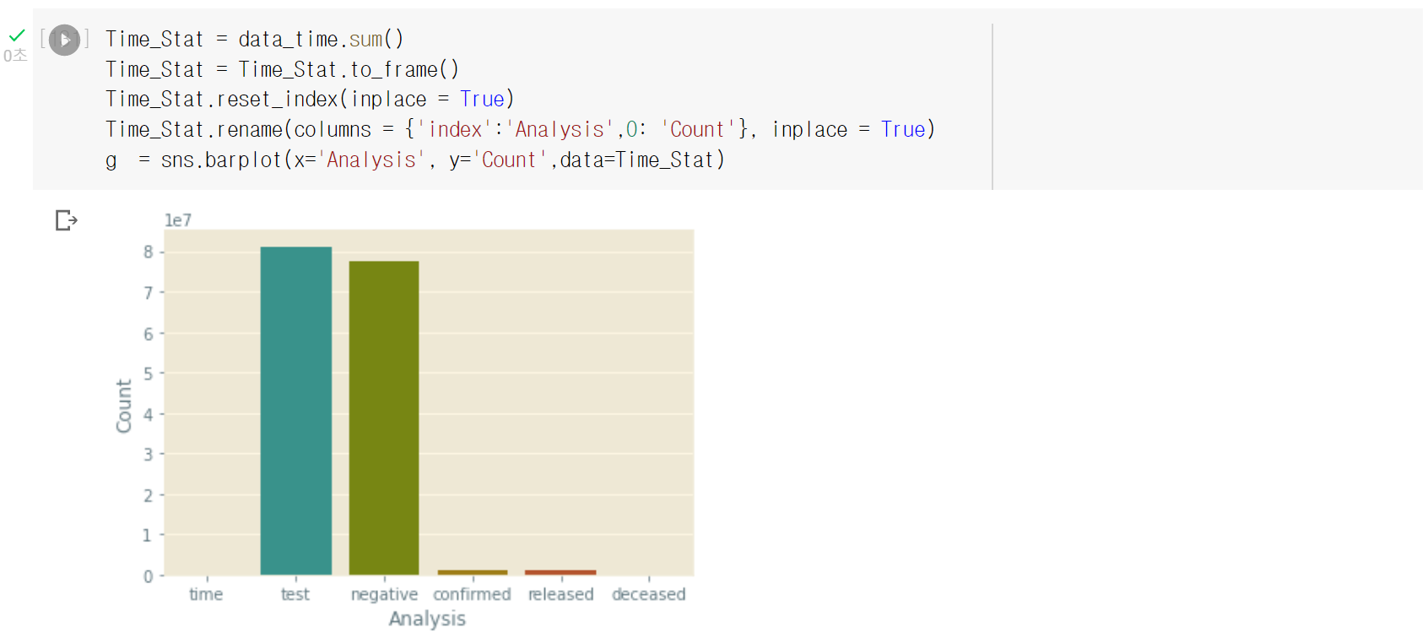
Import seaborn libarary to make statistics

Slide 13
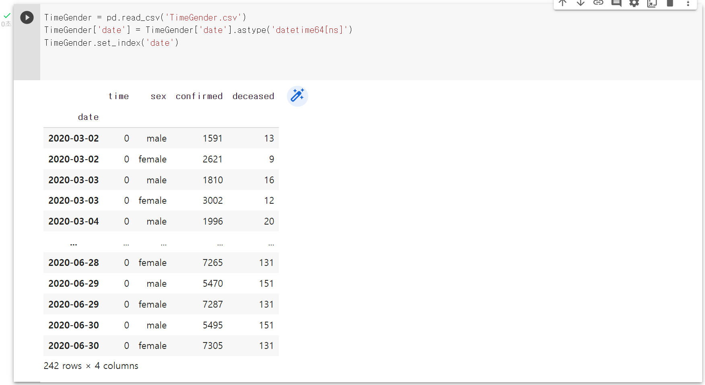
Time gender analysis

Slide 14
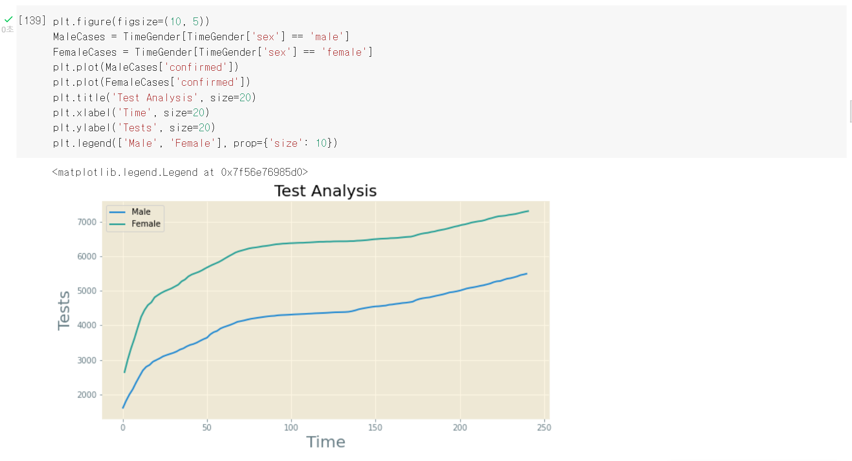
Install dataset from kaggle

Slide 15
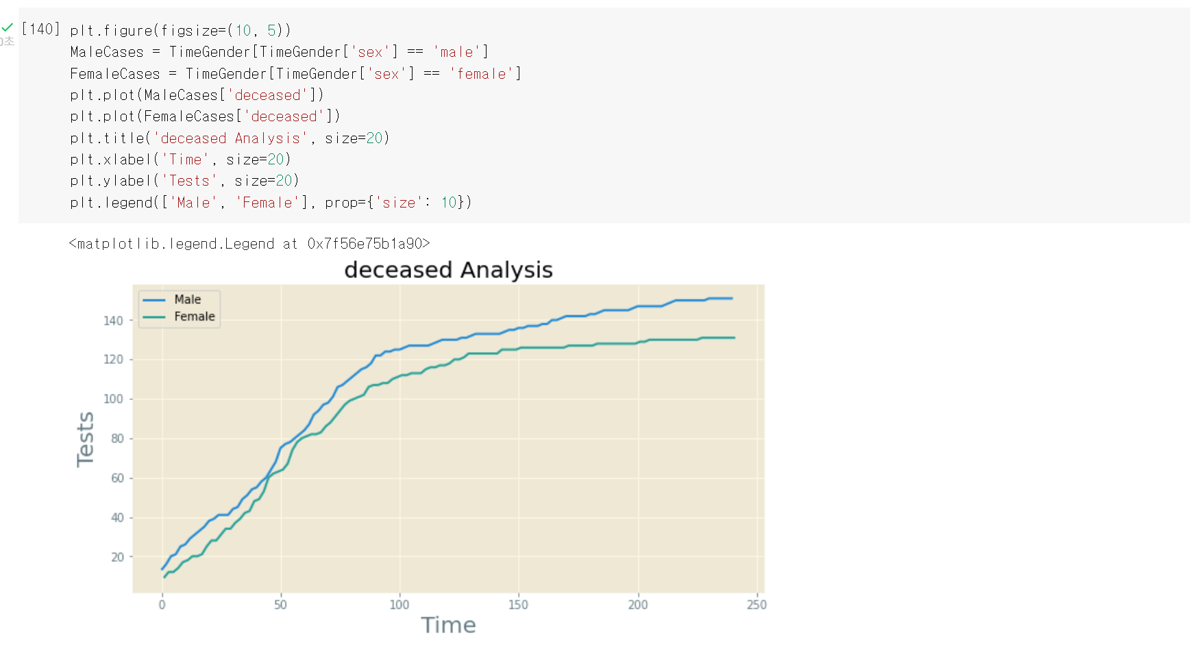
Install dataset from kaggle

Slide 16
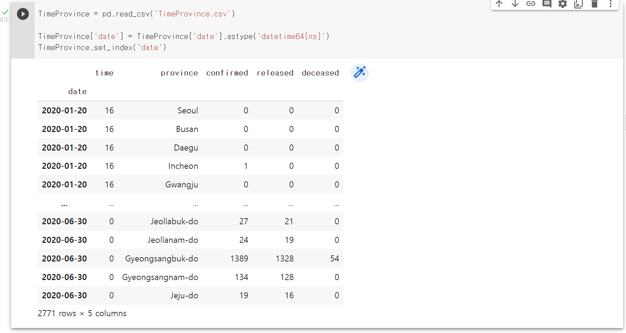
TIMEPROVINCE ANALYSIS

Slide 17
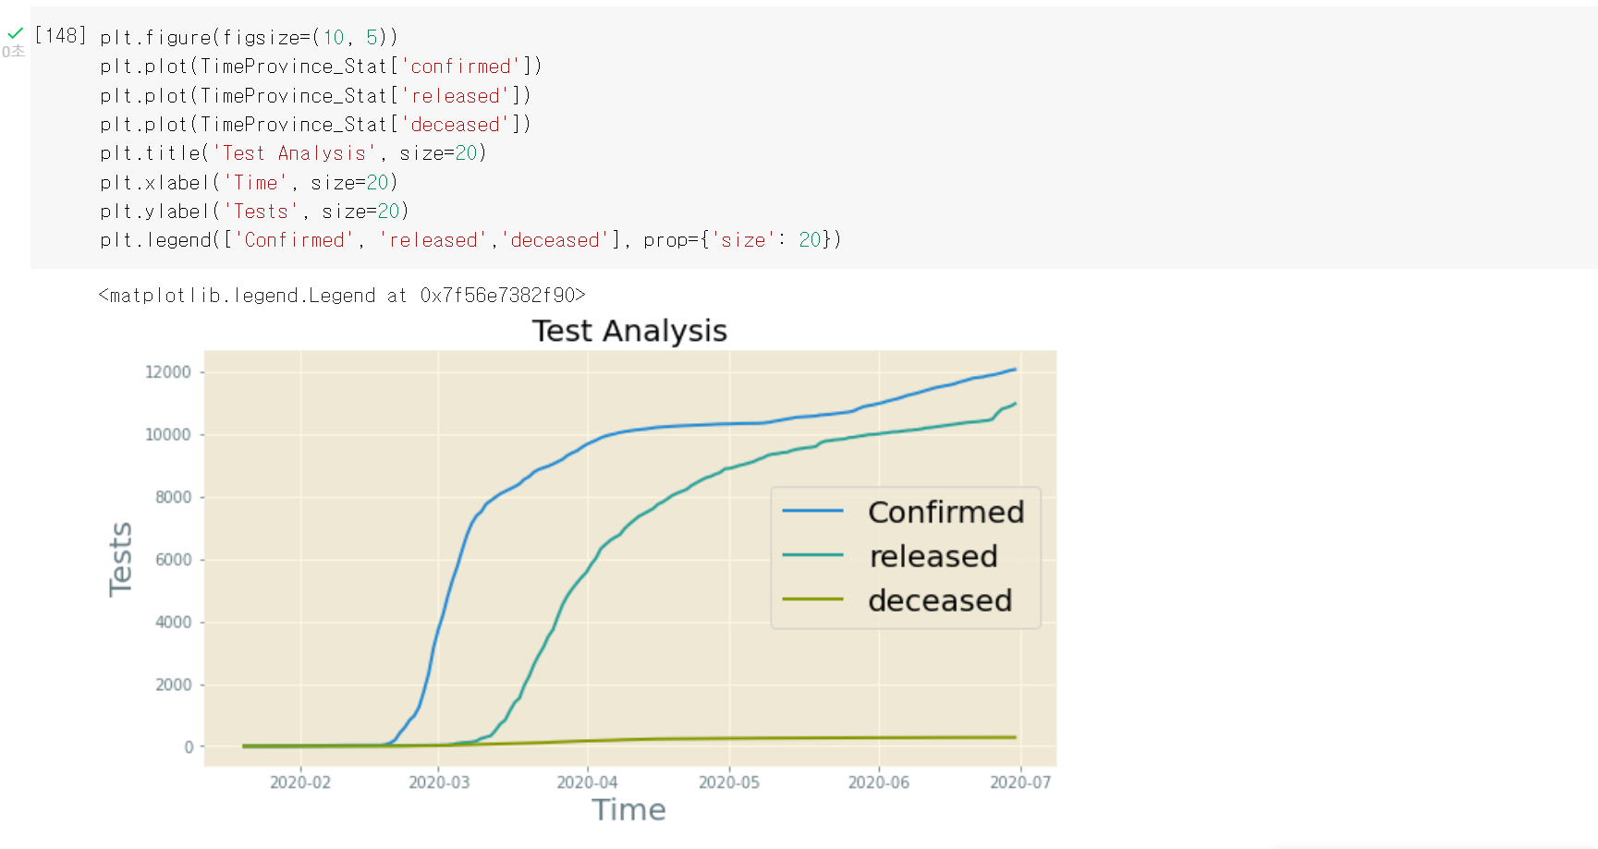
TIMEPROVINCE ANALYSIS

Slide 18
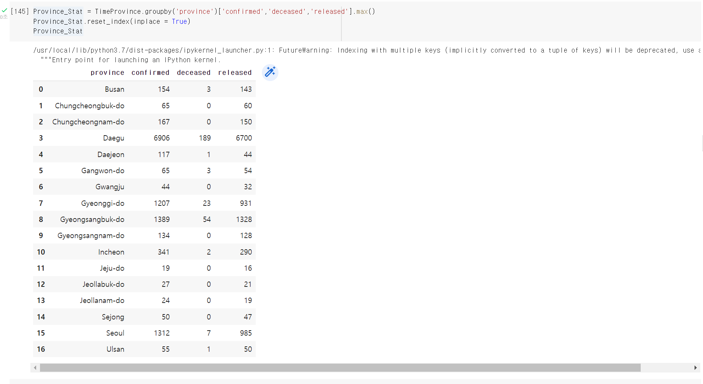

Slide 19
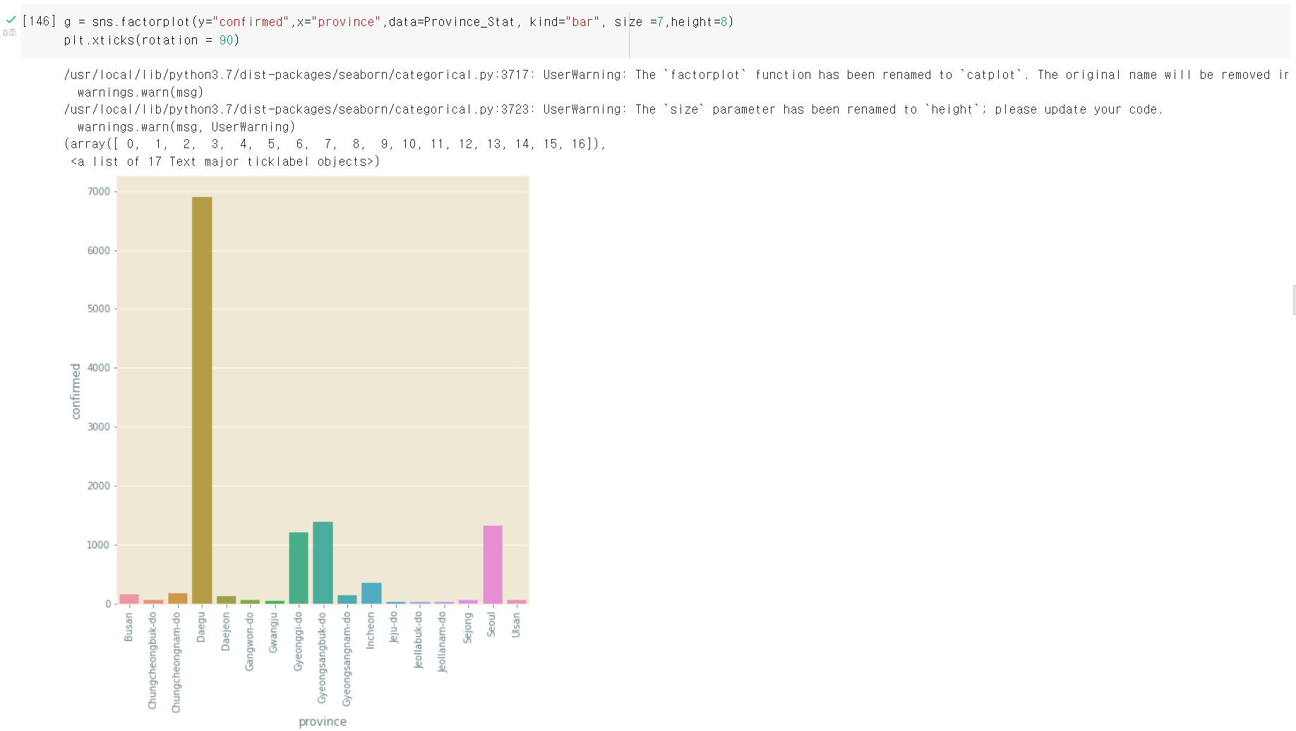
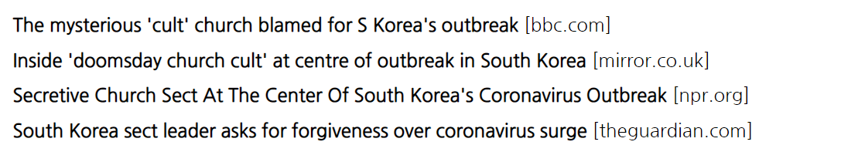

Slide 20
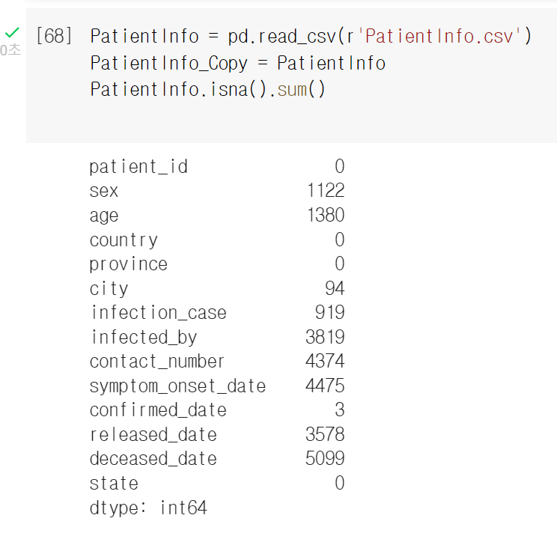
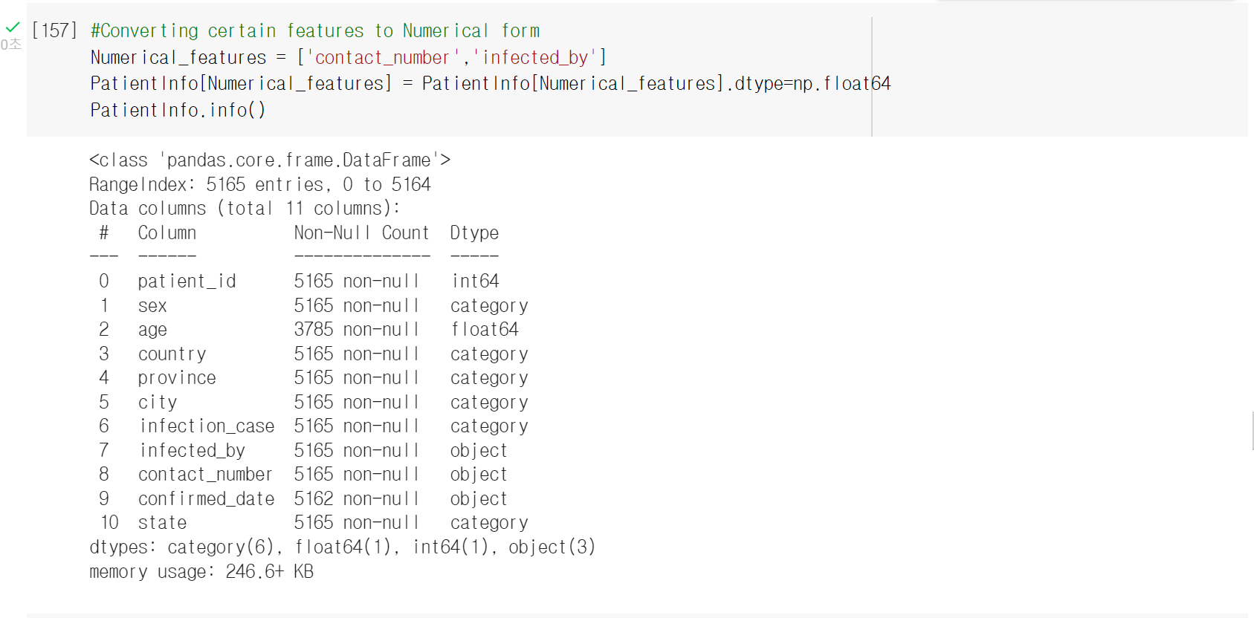
Converting to certain form using patient info

Slide 21
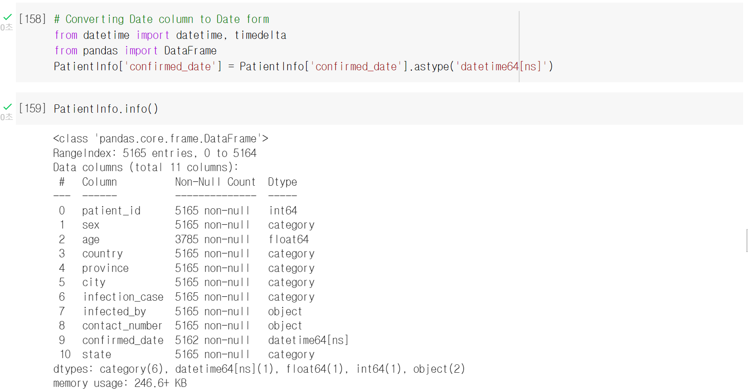

Slide 22
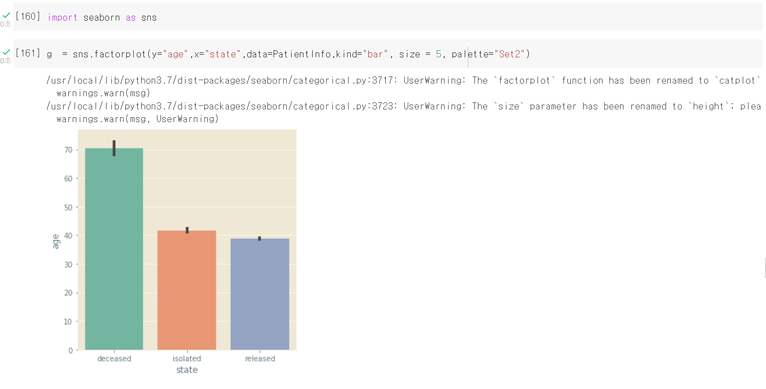

Slide 23
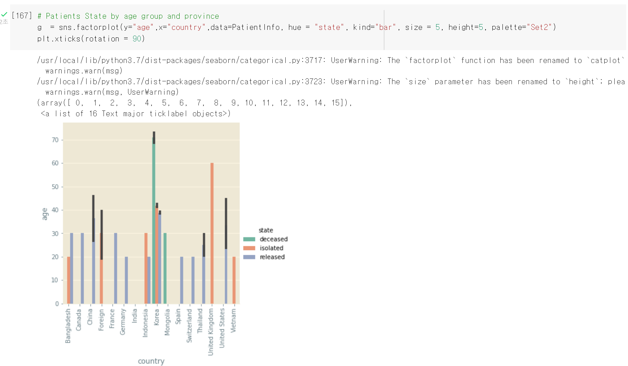

Slide 24
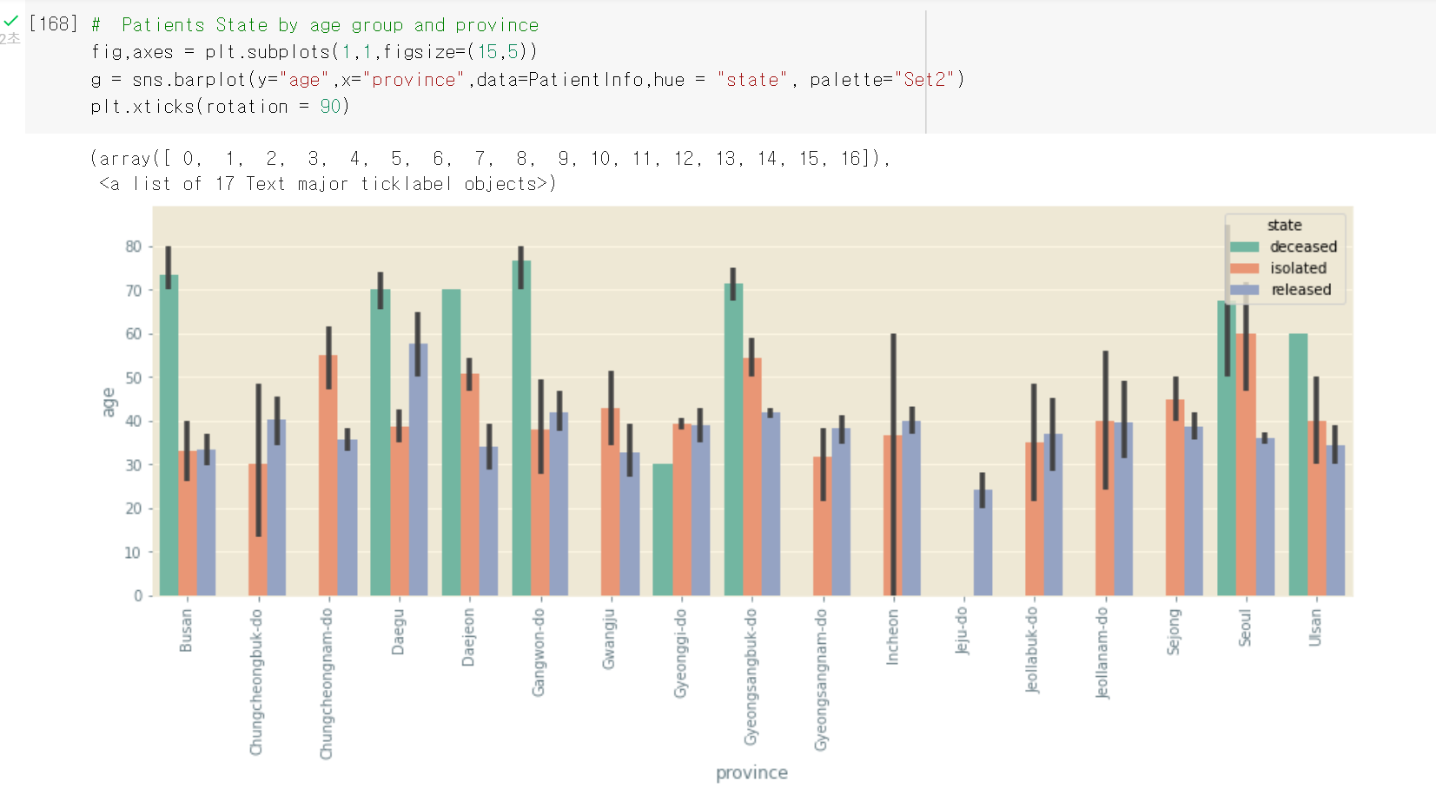

Slide 25
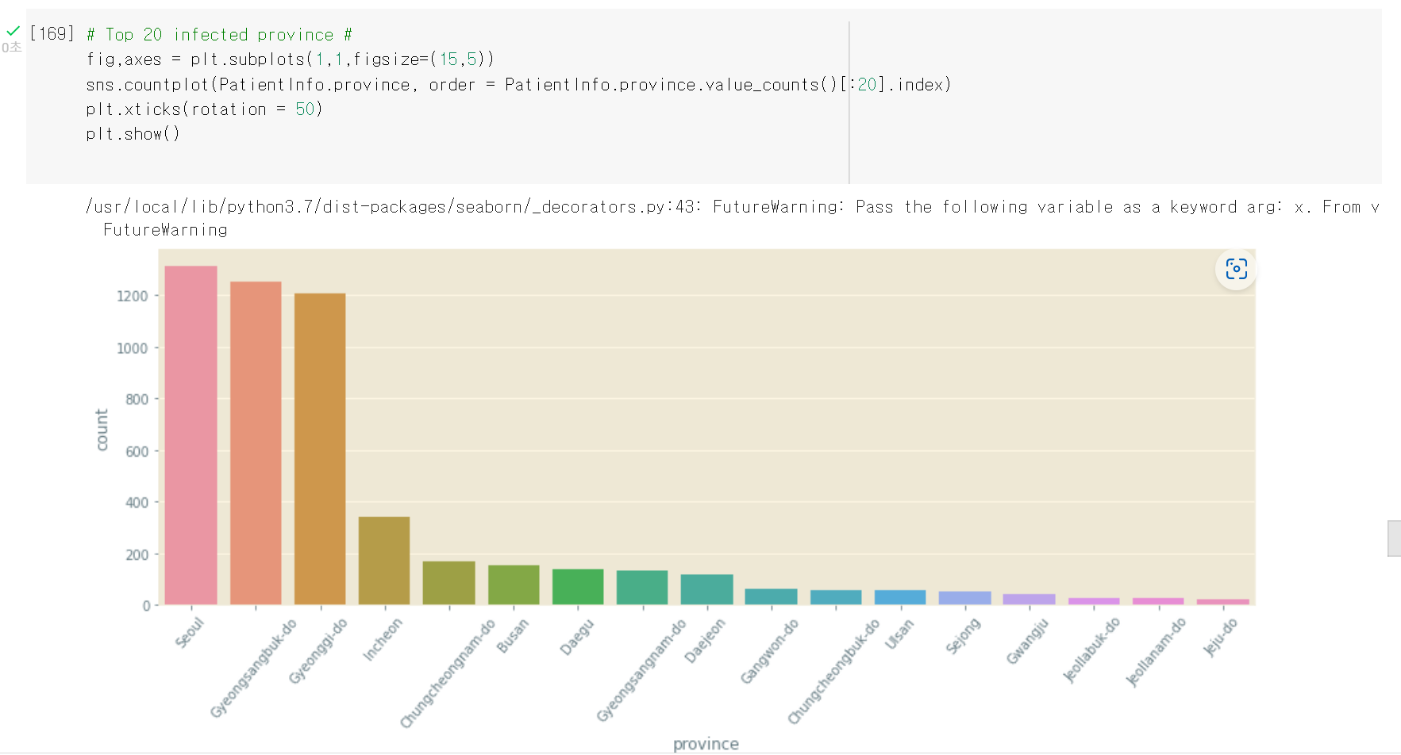

Slide 26
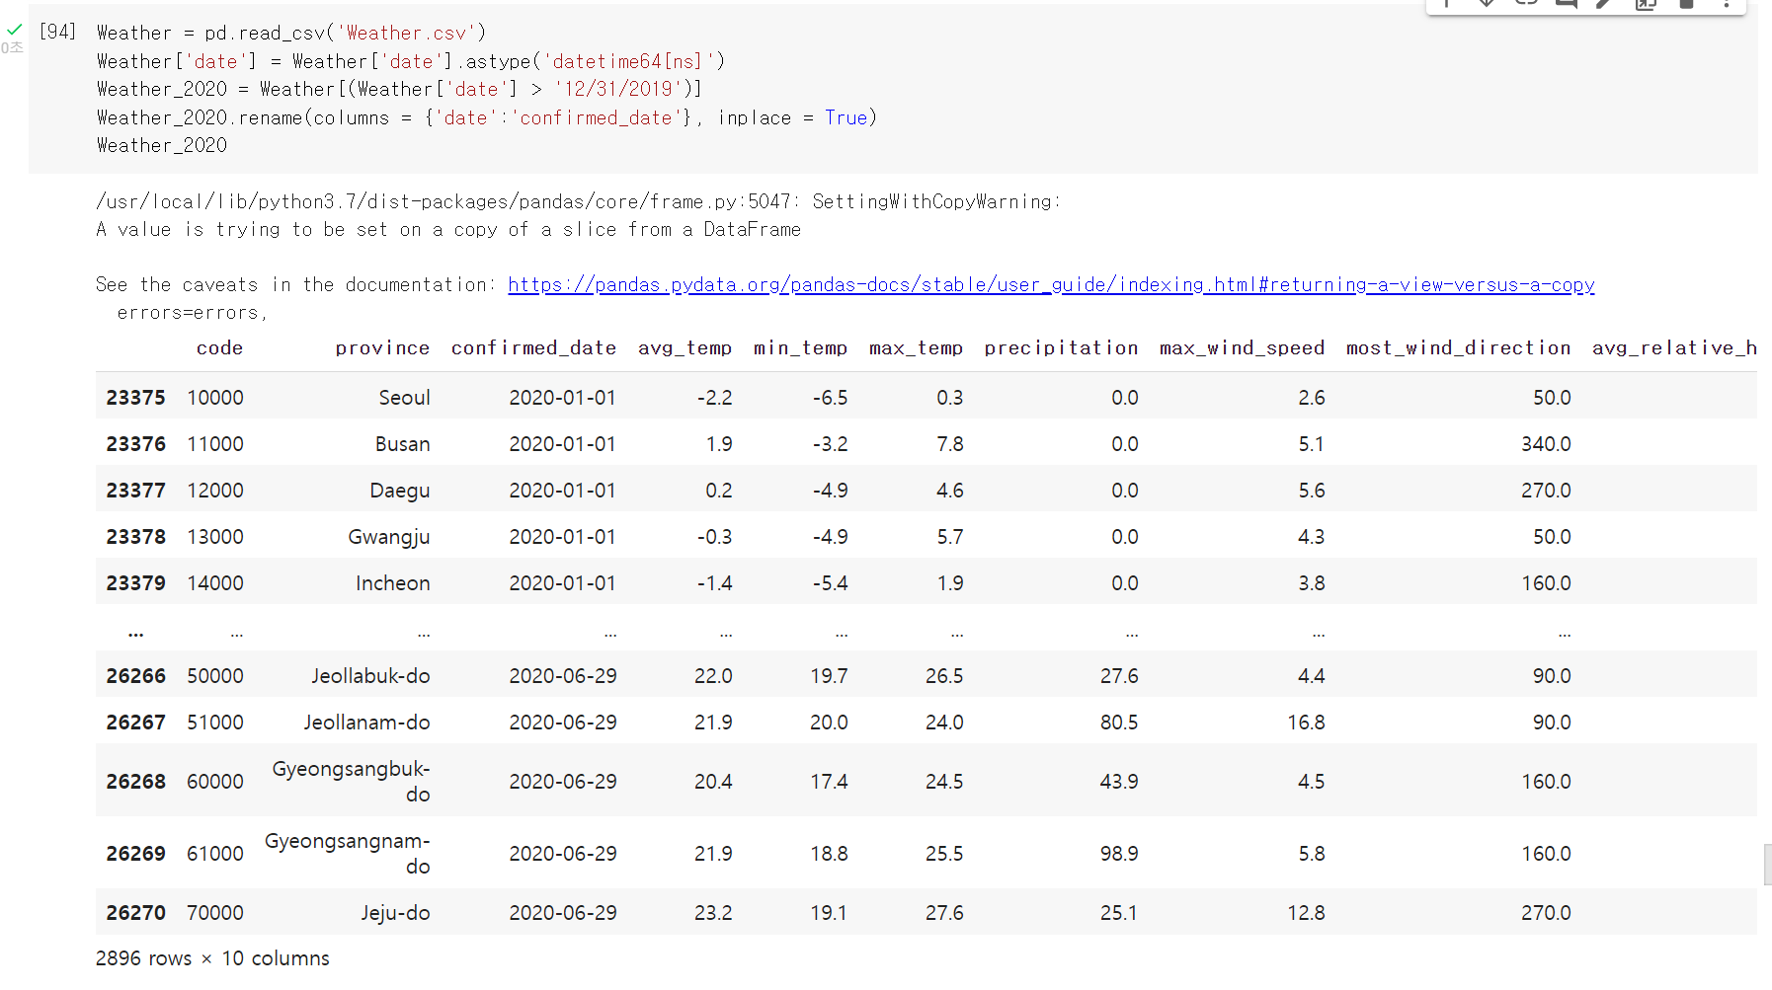
Data merging

Slide 27
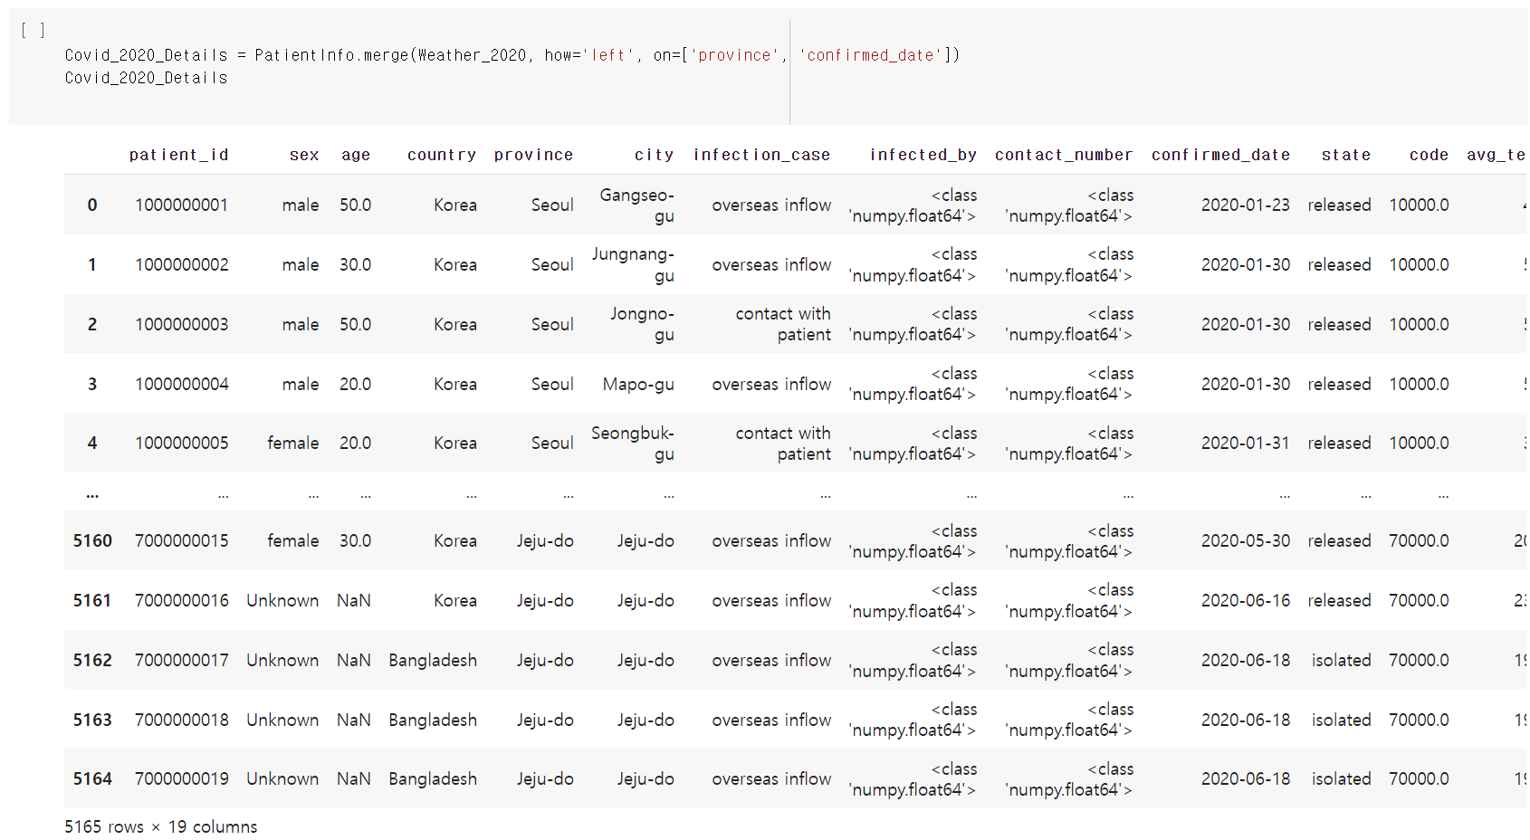

Slide 28
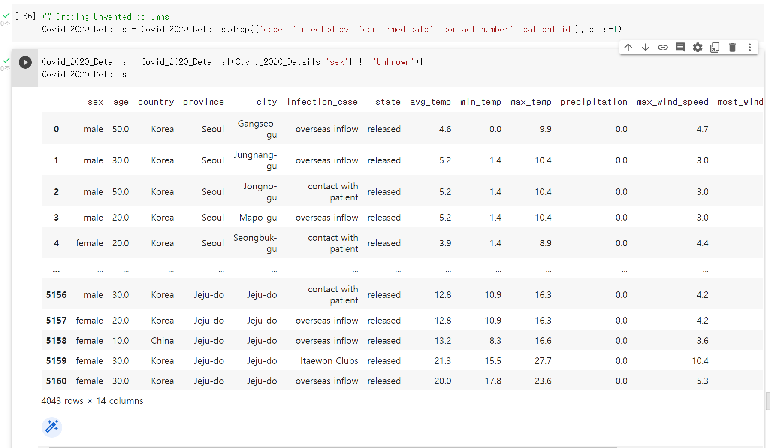

Slide 29
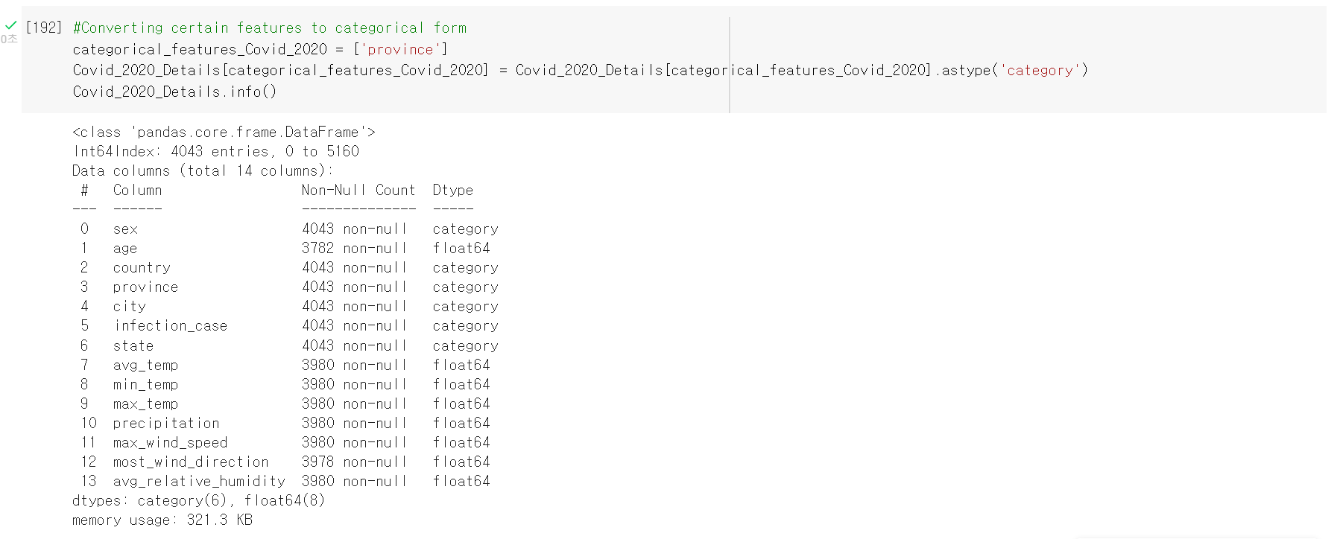

Slide 30
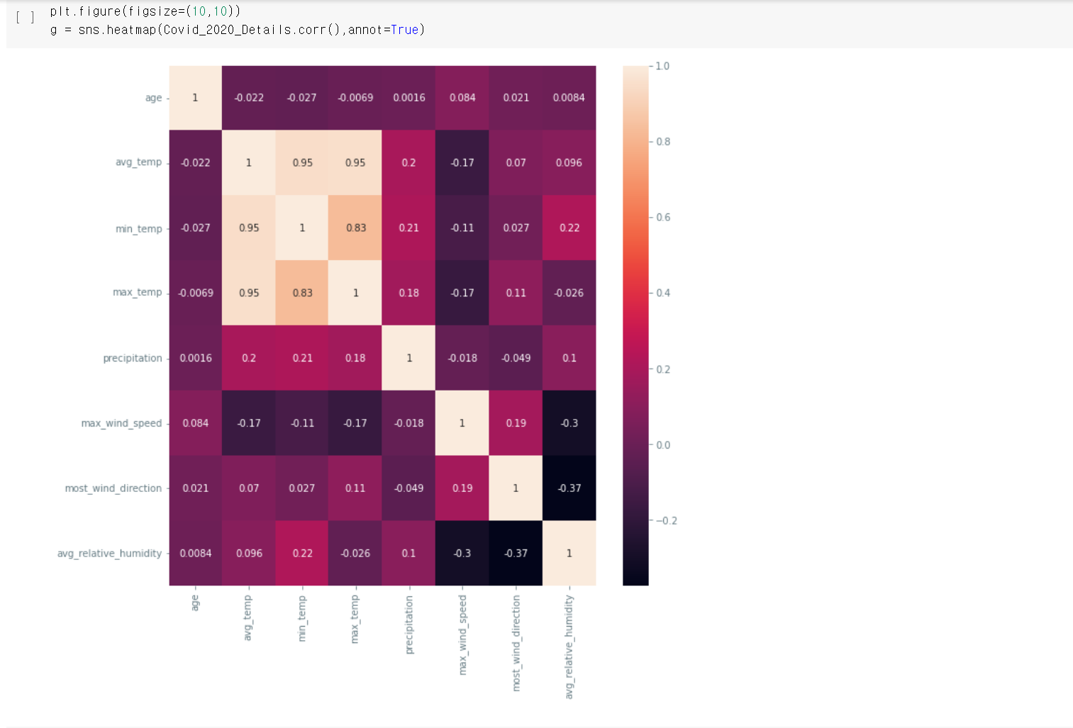
Seaborn heatmap

Slide 31
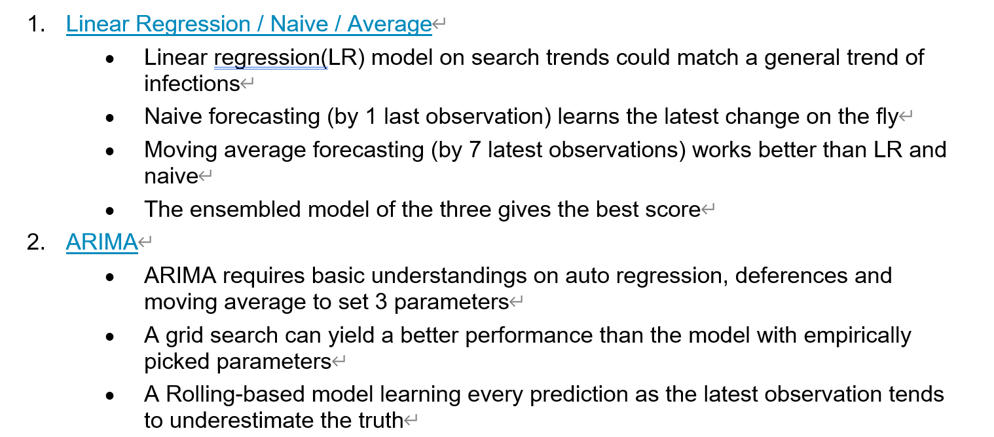
Lesson from the Predictions modeling

Slide 32
About predictions
1. How can machine (learning) help us deepen the understandings from EDA?
While our human eyes used to focus more on what happened already, machine may look beyond to the future objectively and systematically
2. How much worthy or useful is it to predict the number of infections or deceased victims?
It could help decision makers select more efficient and timely measures to tackle the new cases. It might be helpful for individuals to know how much we need to be serious on preventing efforts What could be fundamental or neccessary too for anyone in the storm of pandemic? -A general forecasting model not only for South Korea but for all countries. especially for the ones showing the early pattern of spreading.
-Ways of allocating necessary medical resources nationwide or even worldwide (e.g. ventilator).
-from the places with the decreasing trend to those with the increasing one.

Slide 33
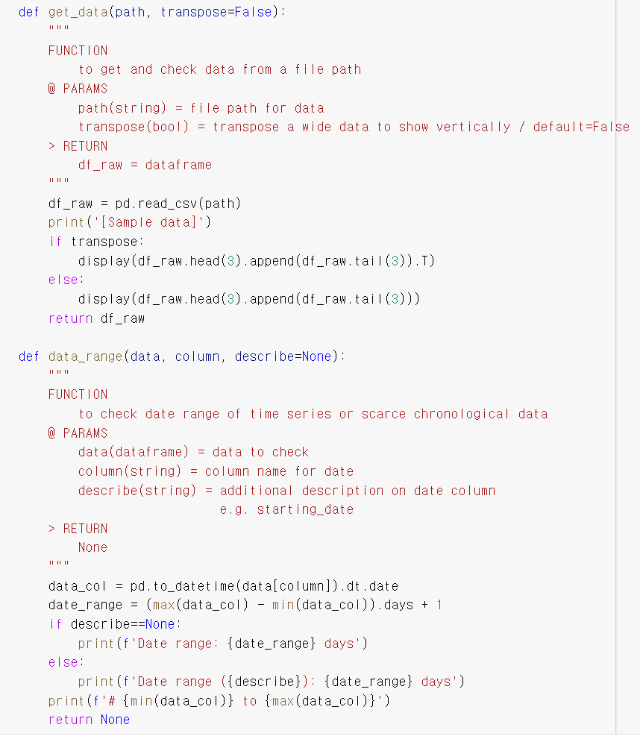
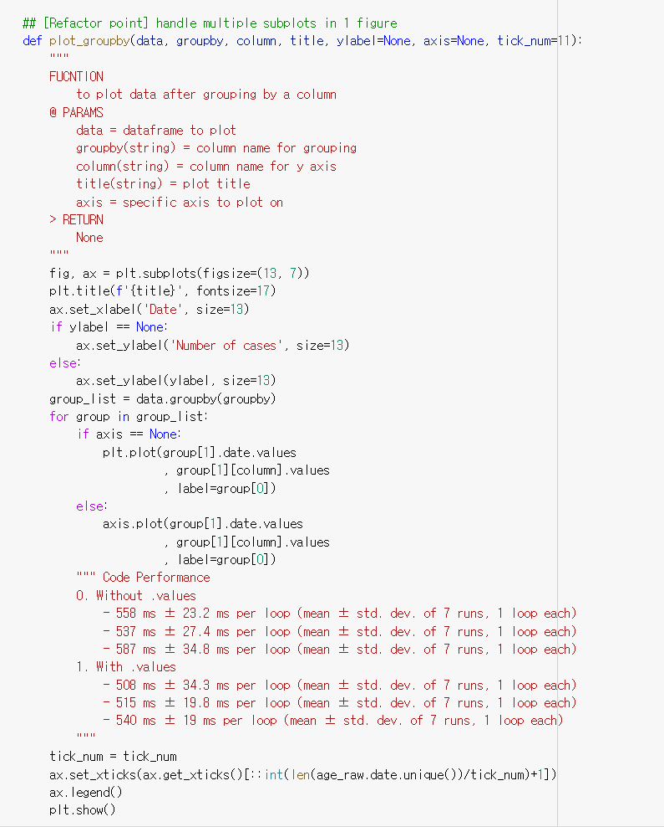
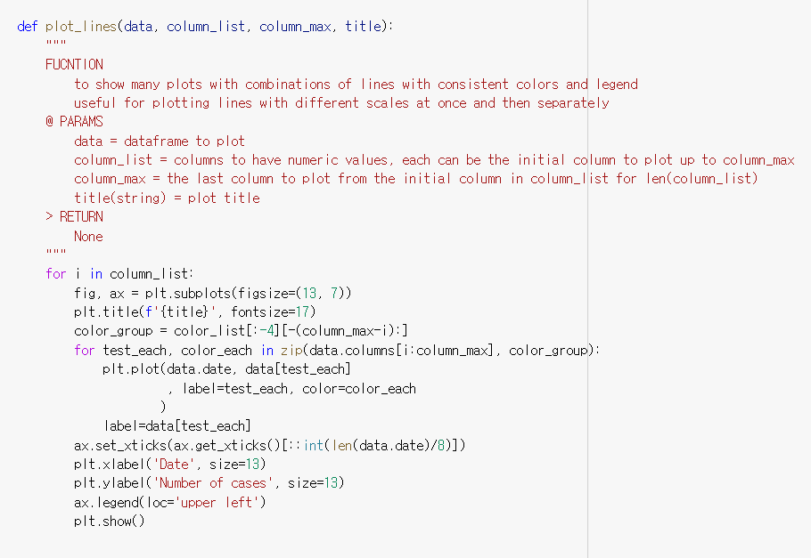
FUNCTIONS THAT I USED

Slide 34
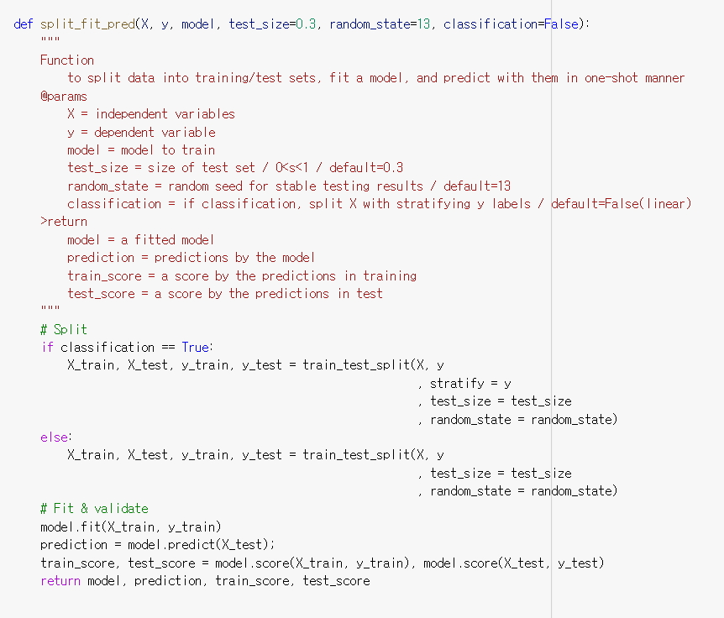
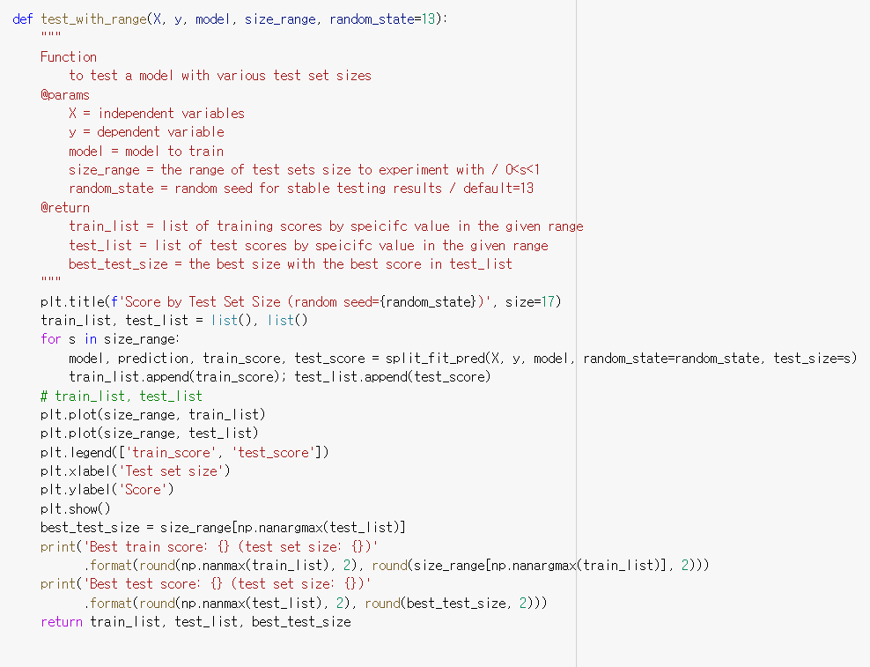

Slide 35
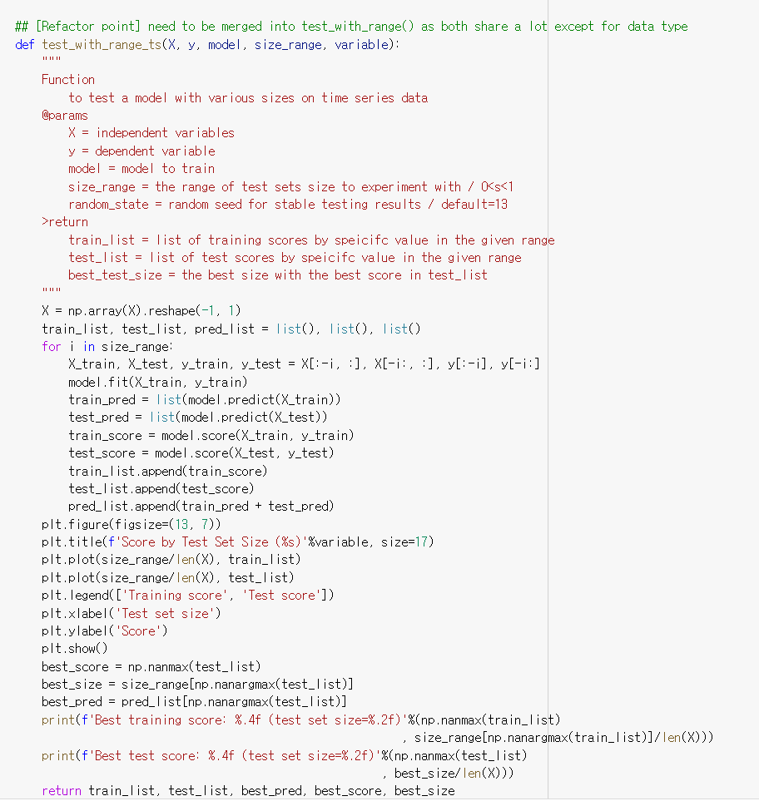

Slide 36
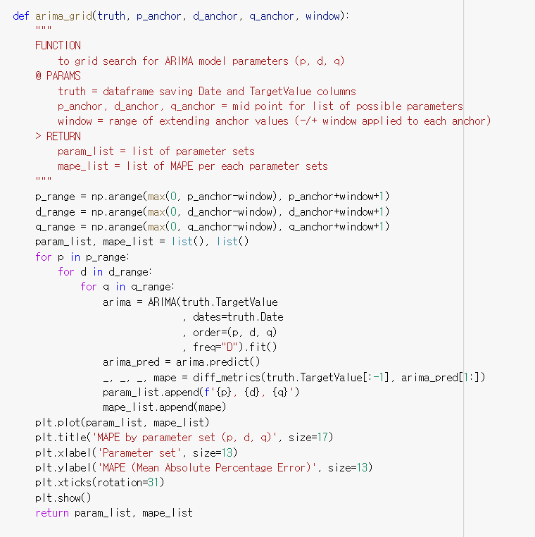
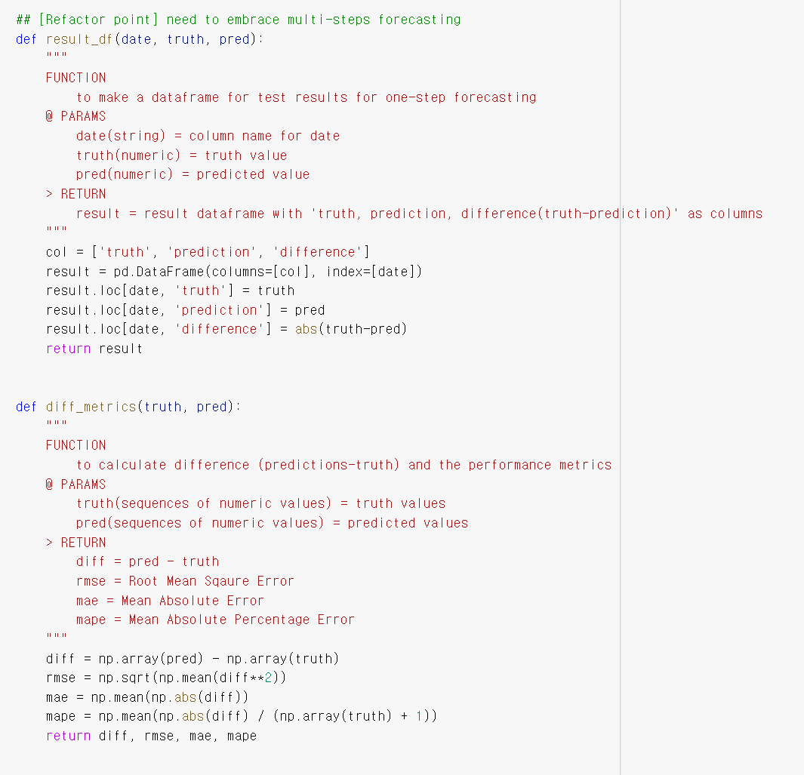

Slide 37
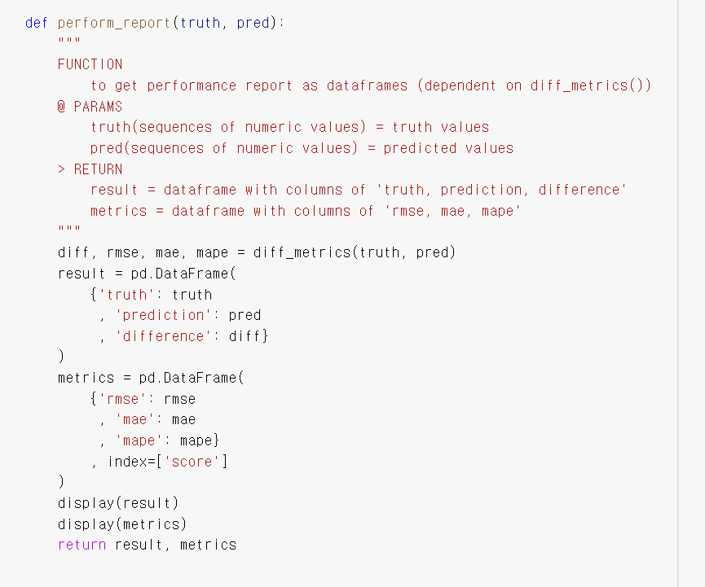
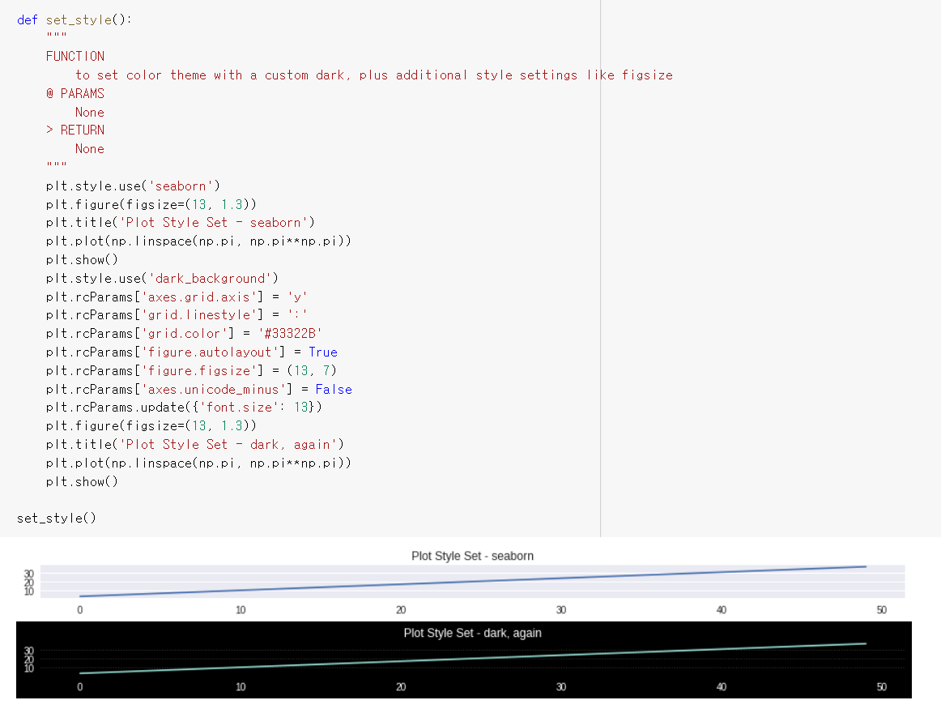

Slide 38
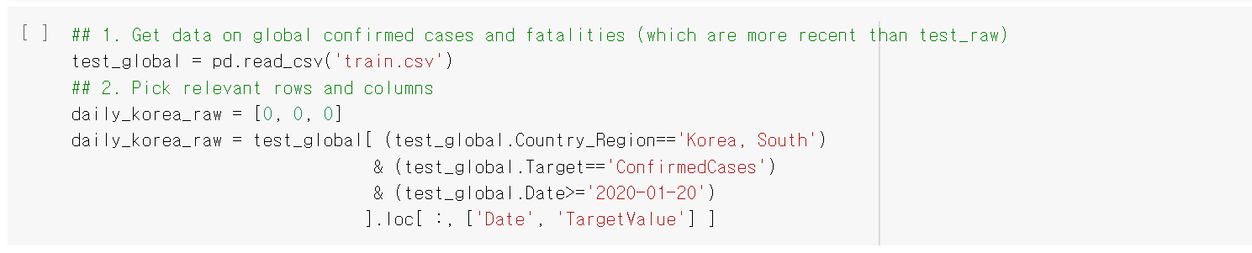
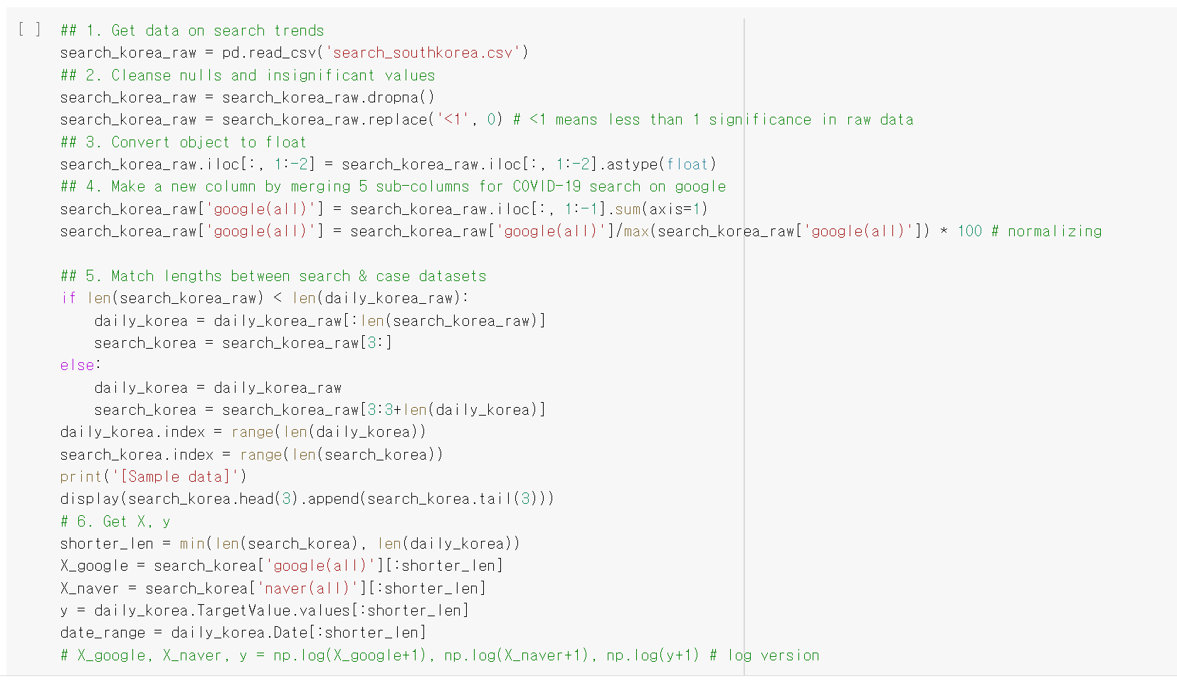
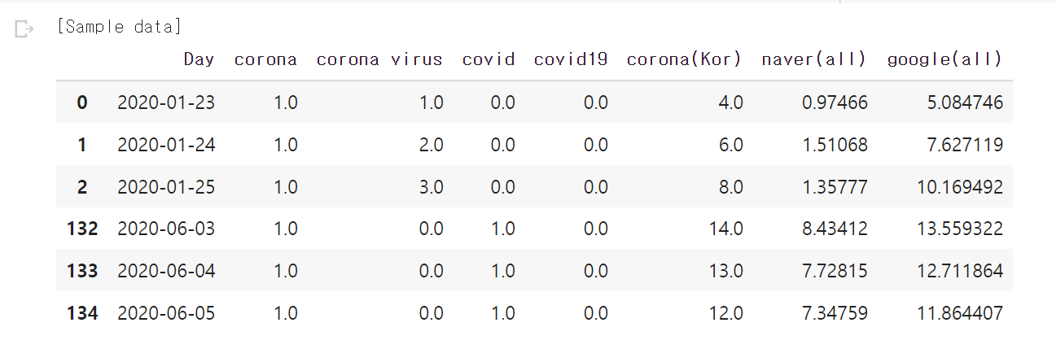
Data modeling – prediction with linear regression
Search trends
[RESULT]

Slide 39
Data Description
Daily search trends since the day with the first confirmed case in S.Korea
Google offers the trend of an individual word, so we use 5 columns for 5 search queries related to COVID-19
we merge them into one column (relative significances among words applied)
'corona' + 'corona virus' + 'covid' + 'covid19' + 'corona(Kor)' = 'google(all)’
Naver gives the cumulative result on up to 20 words for 1 search topic
Now we gather a new search trends data from Naver for the same date range as Google's
to account the relative interests only after the first case (not after 2016-01-01 as in search_raw)

Slide 40
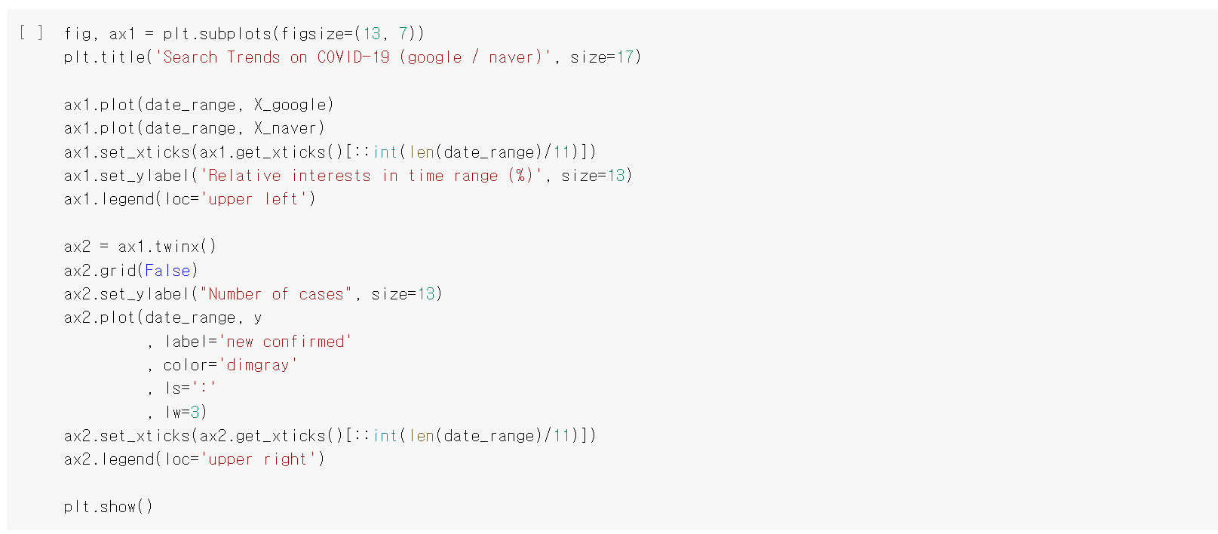
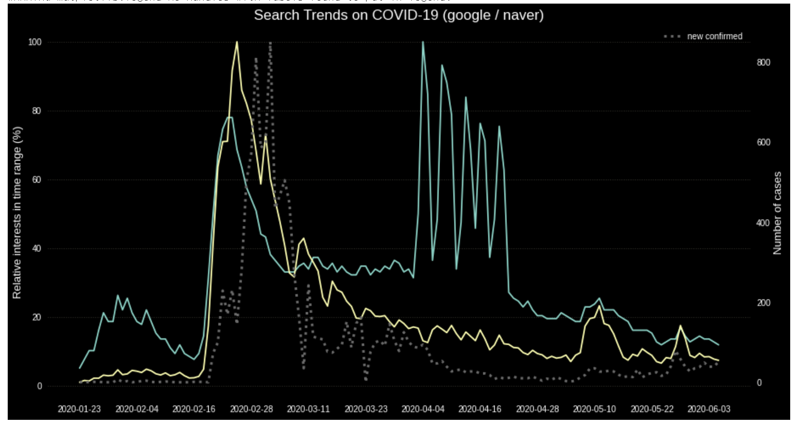

Slide 41
Snap Analysis - Google search trends on COVID-19
Naver trends have a lot more similar pattern to daily confirmed cases than Google's
Google trends show some random fluctuation for the first 3 weeks in April
1) This mainly came from the query of corona in Korean
2) It seems unreasonable that there were more interests 1 month after the peak of confirmed cases than at the peak
3) There might be systematic errors or causes to raise the frequency of queries for this period
By its similarity, Naver trends are expected to be more useful for forecasting the confirmed cases Let's experiment with a linear regression model first

Slide 42
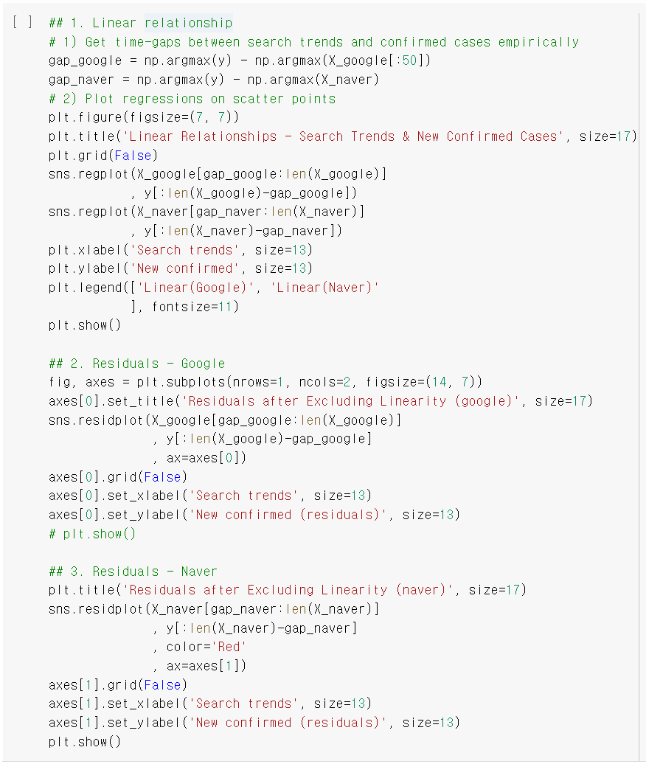


Linear Relationships / residuals after excluding linearity

Slide 43
Snap Analysis - linear relationships / residuals
Naver trends show a stronger positive linearity than Google trends as expected by the similarity of shapes
but this result is not definitive since we applied the time gap between the peaks of two graphs for overlapping them better
Both residual plots seem not random (thus not stationary) yet
which means a simple linearity can't explain the relationship of search trends and confirmed cases solely
We better run the actual model to check if the search trends have any (limited) potential to predict infections

Slide 44

LINEAR REGRESSION

Slide 45


Slide 46

NAVER TRENDS
Result Analysis - score by test set size (Naver trends)
Training score: similar pattern to that of Google trends
(1) Best score 1 comes with test set size 0.98 (same as Google)
2.Test score: far better than Google trends
This is expected by the similarity of shapes
(2) The best test set size is about 70% of the data

Slide 47

check the actual predictions with each model's best size

Slide 48




Slide 49


Train / test with the mean of two best sizes

Slide 50
Result Analysis
The fluctuations of Google are applied reversely
By this effect, the model gives negative predictions
Negative values are not applicable to daily new confirmed cases

Slide 51


0-FLOOR THE PREDICTION

Slide 52
Result Analysis
Most predictions in testing turn into 0, with improving the score
But this doesn't solve the problem of poor prediction itself
In conclusion, Naver-only model works best on the data up to now
- but it's not an actual forecasting yet
- as the model relies on the given search trends in future days
- which can't be accessible beforehand in practice (like the daily cases) We better learn about and apply time series forecasting to use the case value itself as a training set

Slide 53

Time series forecasting - naive / average naive: the 1 latest observed truth is the next prediction average: the average of 7 latest observations is the next prediction

Slide 54


Slide 55

ENSEMBLE AND COMPARE MODELS

Slide 56

Result Analysis
Average works better than naive
Cause it is less sensitive to the latest change than naive
Linear regression model on Naver search trends shows a comparable score to average's
we can get a better score by ensembling both predictions 'LR(Naver) + average'
'LR(Naver) + naive' also shows a performance gain but not as big as that with average
When we combine all of the 3, it gives a little bit better score than LR + average set

Slide 57

[Germany] a country with reasonably larger values of variables than S.Korea
Population - Germany: 83,149,300 / S.Korea: 51,780,579
Confirmed rate - Germany: 2,198 / S.Korea: 226 (per 1 million people)
Google market share - Germany: 92.86% / S.Korea: 76.52%

Slide 58


Slide 59

Snap Analysis
The peaks of search trends are prior to that of daily cases with about 2 weeks of interval
This showed in the graph for S.Korea too with a shorter interval (1 week)
Not only the global shape but also the small spikes have the similarity to the truth
e.g. around 2020-02-29, 2020-03-21, 2020-04-05

Slide 60

Linear regression with Google search trends

Slide 61



Slide 62

Naive / average forecasting with daily confirmed cases

Slide 63


Slide 64

Compare all models

Slide 65



Slide 66
ARIMA
ARIMA - A statistical model for time series forecasting (AutoRegressive + Integrated + Moving Average)
AR (autoregressive): checks and uses the dependent relationship between the truth and the lagged value of it
I (integrated): subtracts previous values from the truth to make the time series stationary
stationary means the values are random without trend, seasonal or cyclic patterns
MA (moving average): uses the moving average of residual errors for forecasting future values
similar to moving average of truth values above
but of residual errors than the values themselves

Slide 67

Snap Analysis - autocorrelation of daily confirmed cases (S.Korea)
The values show significant correlations with the truth up to 10 lag
- which means the lagged (previous) values of the truth could be useful
We choose 10 lag as the parameter of p(AR part) in ARIMA model
Lag 38 reaches the significance threshold with 99% confidence
- but not with 95%, thus we won't use it

Slide 68


Snap Analysis - residual errors of ARIMA on daily confirmed cases
The errors show a random spread around the 0 horizon
There seems some left informations the model can use but not extracted yet
Especially around 2020-02-29 (near to the peak of the truth) could have them

Slide 69


Snap Analysis - residual errors of ARIMA on daily confirmed cases
The errors show a random spread around the 0 horizon
There seems some left informations the model can use but not extracted yet
Especially around 2020-02-29 (near to the peak of the truth) could have them
Residual errors seem normally distributed, with 0 mean

Slide 70


check the actual predictions
Result Analysis - ARIMA (one-step forecasting for every date)
ARIMA model gives one-step prediction for every date
We apply -1 step to all predictions for overlapping them with the truth
The model fits the truth to some extent visually and numerically

Slide 71

We have implemented some insightful performance error metrics such as
root mean squared (RMSE),
mean absolute error (MAE),
mean percentage error (MPE), mean absolute percentage error (MAPE)

Slide 72

Result Analysis - ARIMA (with parametrs found by gird search=11, 2, 0)
MAPE improved 12.61% (from 0.6253 to 0.5464)
Visaul fitting, RMSE, and MAE also show better results
But this could lead overfitting

Slide 73



Slide 74
Result Analysis - ARIMA (small-step forecasting, step size = 13)
MAPE gets 41.12% performance gain (from 0.5464 to 0.3217)
this is not only from the actual performance change - but also from the shorter length of testing period (13) this time
as we applied one step forcasting for all days (140) above
2. The actual predictions by ARIMA tend to underestimate the daily confirmed cases
3. the global trend the model learned must be same in the future
- this could be overcome partly by feeding ARIMA with the lastest truth all the time (like naive forecasting)

Slide 75
Thank you for watching
Dataset source link
[NeurIPS 2020] Data Science for COVID-19 (DS4C) | Kaggle
COVID19 Global Forecasting (Week 5) | Kaggle
COVID-19 search trends (by mainly Google Trends) | Kaggle
Novel Corona Virus 2019 Dataset | Kaggle

